Slide 1
Tensorflow 2.0
Top New Features
By
Vishal Prem

Slide 2
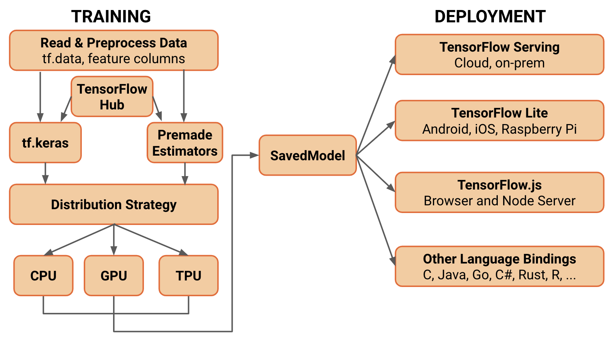
Tensorflow 2.0 Primary Architecture

Slide 3
Object Oriented Programming
Variables scopes and sessions are replaced with class based architecture
Session calls are replaced by Python functions
Similar to PyTorch Methodology
Removable of graph collections
Custom Layers can be written as Classes
Keep track of variables using standard python pointers.
The @tf.function annotation can compile any function as a graph

Slide 4
Eager Execution
Eager execution is a methodology that overrides the old paradigm of just creating handles to nodes in a computational graph.
It evaluates operations immediately, without building graphs: operations return concrete values instead of constructing a computational graph to run later
Use Python control flow instead of graph control flow
It's easy to inspect results using print() or a python debugger.

Slide 5
Tighter Integration with Keras
Keras packages predefined layers that can easily be stacked in a Sequential model object that tracks the variables, and regularization losses.
These models support arbitrary callables as losses and metrics.
These models completely removes to worry about variables reusing, issues on graph redefinition

Slide 6
Simpler Input Pipelines
Models accept Numpy arrays, Python generators and, tf.data.Datasets
Tf.data makes it extremely simple to load data into our models.
It contains utilities for predefined datasets for easy prototyping.
Easy python looping based iteration over batches

Slide 7
Writing our own training loops
If we don’t want to use the keras fit function we an manually create loops to train the batches
This allows us to customize the training flow and how we collect metrics
Very similar to Pytorch Training Loops
Metrics are accumulated unless we reset them between batches.

Slide 8
Distributed training
tf.distribute.Strategy is a TensorFlow API to distribute training across multiple GPUs, multiple machines or TPUs.
No major changes to the code needed to implement distributed training as TFv2 is build from the ground up keeping distribution in mind
Its tightly integrated with Keras
Define which parts of the code will be distributed using scope
Major types include Mirrored and TPU based training
More in development

Slide 9
Saving Models
Tensorflow 2.0 uses object based checkpoints to save models in two ways ie. Checkpoints and SavedModel
Checkpoints just store the parameter values without any data about the computational model. They can only be restored if the source code model is available.
The SavedModel includes a serialized description of the computation defined by the model in addition to the parameter values (checkpoint). Models in this format are independent of the source code that created the model.

Slide 10
Model Deployment
TensorFlow Serving: A TensorFlow library allowing models to be served over HTTP/REST or gRPC/Protocol Buffers.
TensorFlow Lite: TensorFlow’s lightweight solution for mobile and embedded devices provides the capability to deploy models on Android, iOS and embedded systems like a Raspberry Pi and Edge TPUs.
TensorFlow.js: Enables deploying models in JavaScript environments, such as in a web browser or server side through Node.js. TensorFlow.js also supports defining models in JavaScript and training directly in the web browser using a Keras-like API.

Slide 11
Backwards Compatability
A TFv1 compatibility module is present which retains full support for TFv1 throughout the life of v2
Easily Disable TFv2 behaviour
SavedModels or stored GraphDefs will be backwards compatible.
Automatic conversion script is available to convert from v1 to v2 although Naively

Slide 12
API Cleanup
Simplifying the API by cleaning up deprecated APIs and reducing duplication.

